Slide 1

Working With Data DATA9910
Week 5
Lucas Rizzo
email: lucas.rizzo@tudublin.ie

Slide 2
Schedule
Week 1 | Set up environment and R notebook
Week 2 | Review Python and practice
Week 3 | Importing data with R
Week 4 | Interpreting Data (summary statistics, data visualisation)
Week 5 | Data manipulation in R. Numpy and Pandas introduction in Python
Week 6 | Review week (work on assignment)
Week 7 | Data visualisation in Python
Week 8 | Data processing (regular expressions) Assignment 1 deadline
Week 9 | Intro to databases (SQL)
Week 10 | Loading and extracting data (SQL)
Week 11 | Analytical SQL functions
Week 12 | Procedural SQL
Week 13 | Working on Assignment Assignment 2 deadline

Slide 3
Overview
Data manipulation
Filter
Arrange
Mutate
Join
Group

Slide 4
Baby Names Dataset
Example dataset to practice data manipulation
At a Glance
Top 1000 Male and Female names in the US, from 1880 to 2008
258,000 records (1000 x 2 x 129)
Five Variables year, name, soundex, sex, prop
soundex: code that describes the sound of the name. Names that sound similar will have the same soundex code.
prop: proportion of people of a certain sex with a name born in that year compared to the total births

Slide 5
Task 1 – Import the Data
Import the files bnames.csv.bz2 and births.csv from babyData.zip
Tips in the next slide...

Slide 6
Task 1 - Tips
First you'll need to unzip the files
read.csv can handle bz2 compressed files automatically
Answer in the next slide...

Slide 7
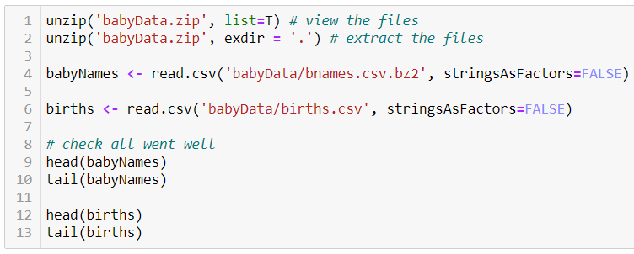
Task 1 - Answer

Slide 8
Task 2 – Explore your Name
Use logical subsetting to extract your name from the dataset (or a name of your choice if yours isn't in it)
Plot the trend over time
What geom should you use?
Do you need any extra aesthetics?
Tips in the next slide...

Slide 9
Task 2 - Tips
Don't forget to load the ggplot2 library!
Check back over last week's work for a guide on how to do this
Examine the dataset for any strange or unexpected values
See if you can find these values in the dataset
Could aesthetics be used to make the cause of these values more clear?
Answer in the next slide...

Slide 10
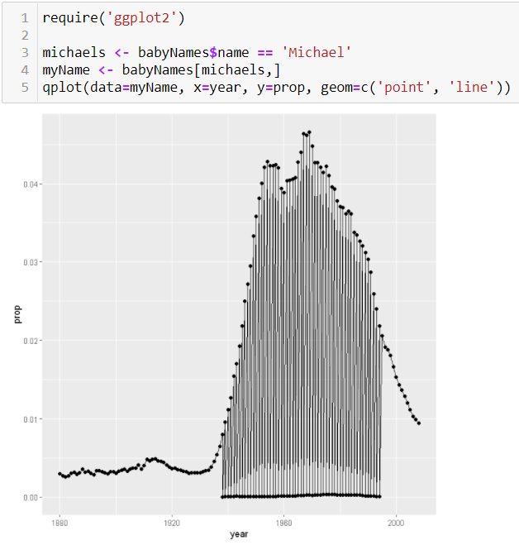
Task 2 - Answer

Slide 11
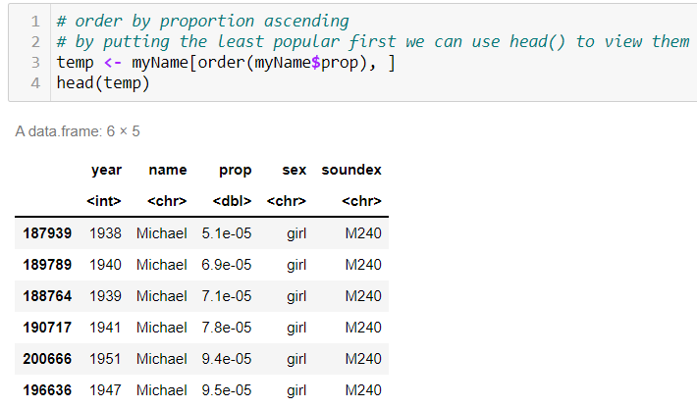
Investigating Outliers
Did you notice the zig-zag patterns in the previous slide? Let's investigate

Slide 12
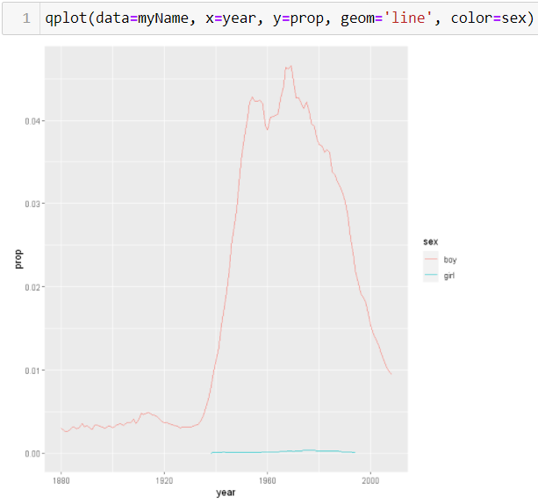
Using the Color Aesthetic to Separate Gender
If we plot the trends for each gender separately we'll get a better overall picture

Slide 13
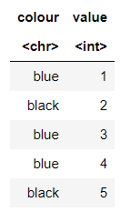
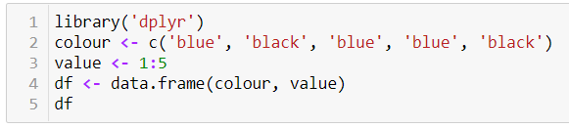
Manipulating Data: dplyr
Let’s try to manipulate data in a different way using the dplyr package.
We'll be using a very basic toy dataset to demonstrate data manipulation

Slide 14
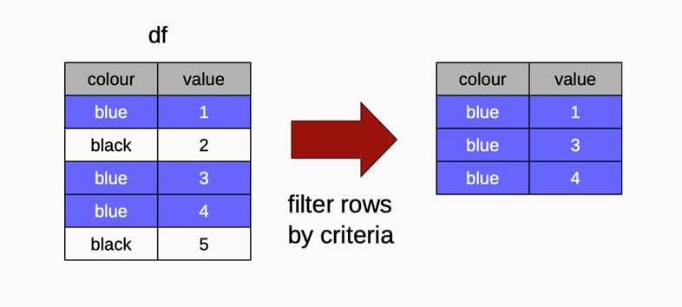
Filtering – Concept
Suppose that we have the following data frame and wish to filter out the rows that have a value ‘blue’ for the colour variable.

Slide 15

Filtering Data
Filtering data allows us to remove rows based on some condition
We've already looked at filtering rows using logical indexing dplyr gives us the filter() function as an alternative
filter(df, expr)
For example

Slide 16
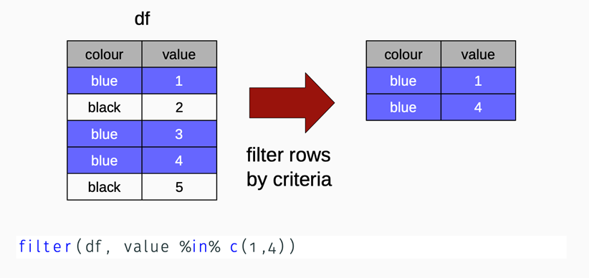
Filtering Data – Another Example
This time we are filtering rows that have 1 or 4 in the value column
Useful operator instead of using multiple “or”

Slide 17
Task 3 – Filter the babyNames dataset
Use the filter function to find all of the girls' names from the year 2000
Answer in the next slide...

Slide 18
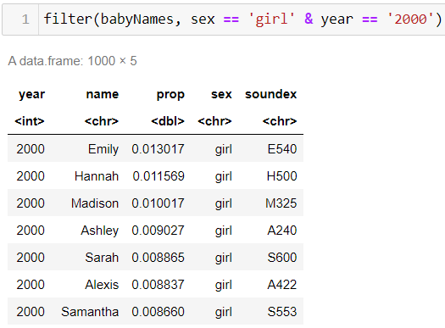
Task 3 - Answer

Slide 19
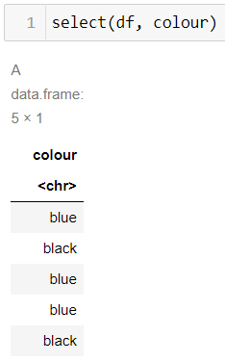
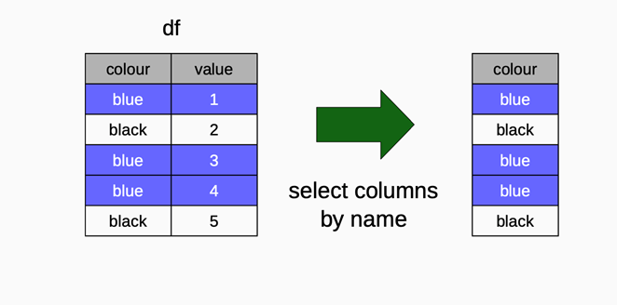
Selecting Data - Concept
Suppose we wish to select the colour column from the dataframe

Slide 20
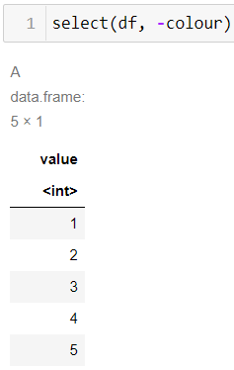
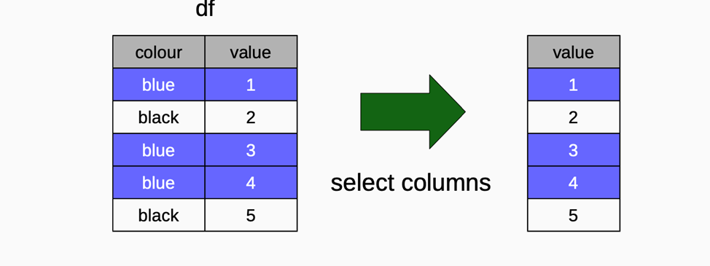
Selecting Data – Another Example
Now suppose we want to select all columns except the colour column

Slide 21
Task 4 – Selecting Columns from babyNames
Select the year, name and sex columns from babyNames
Tips in the next slide...

Slide 22
Task 4 - Hints
Sometimes it's easier to deselect columns you don't want than it is to select the columns you do
Answer in the next slide...

Slide 23
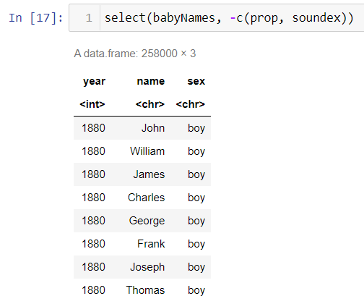
Task 4 - Answer

Slide 24
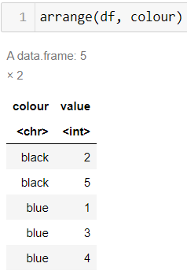
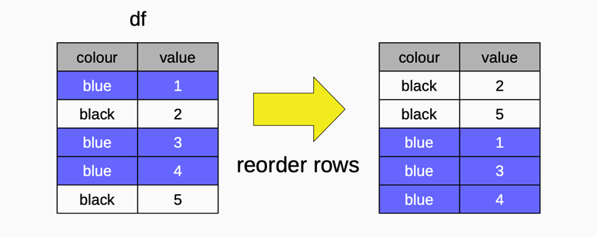
Arranging Data - Concept
We may also wish to arrange the rows of a data frame based on the values of a particular column

Slide 25
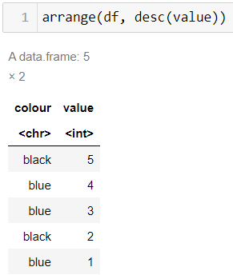
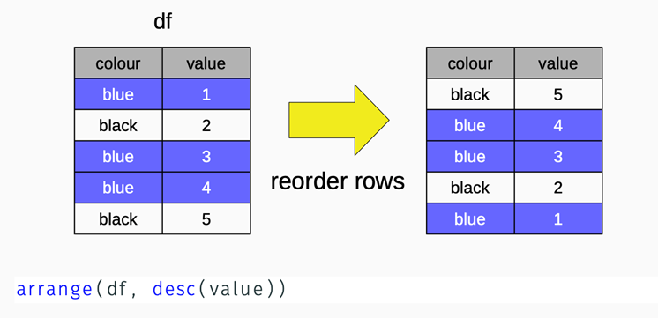
Arranging Data – Another Example
In this example we're arranging the rows based on the value column in descending order

Slide 26

Try it Out
What happens if you run the following R code?

Slide 27
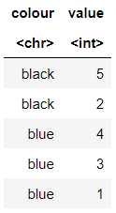
Try it Out
What happens if you run the following R code?
This will sort first by colour (ascending), then by value (descending)

Slide 28
Task 5 – Reordering the babyNames dataset
Reorder the rows of babyNames from highest to lowest based on the prop variable
Which name had the highest proportion in a single year?
In what year did your name have the highest proportion?
Tips in the next slide...

Slide 29
Task 5 - Hints
To find the highest proportion for your own name, you'll first need to filter the dataset. You'll need a temporary variable for this

Slide 30
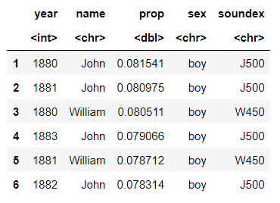
Task 5 - Answers

Slide 31
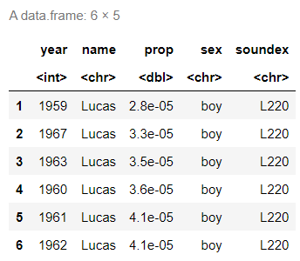
Task 5 - Answers

Slide 32
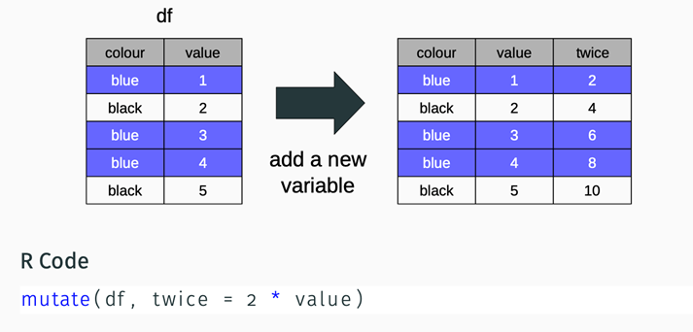
Mutating Data - Concept
Suppose that we wish to change the contents of a dataframe (mutate it) e.g. add a new column by performing a mathematical operation on existing variables

Slide 33
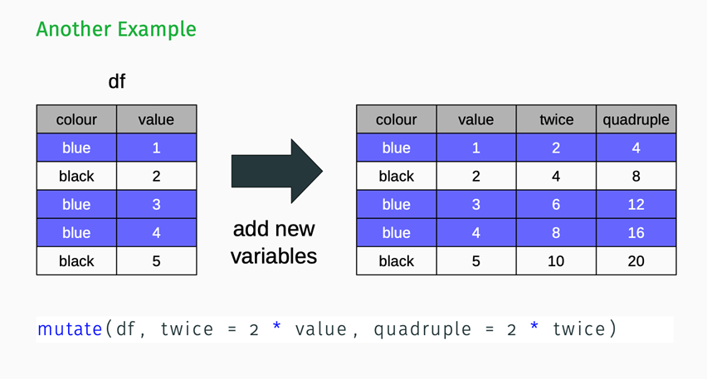
Mutating Data – Another Example

Slide 34
Mutating Data – Try it Out
What happens if you run this R code?

Slide 35
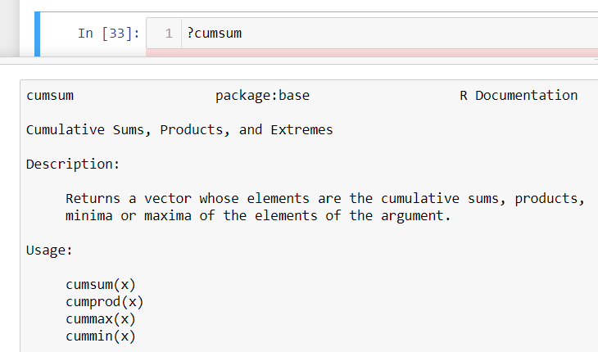
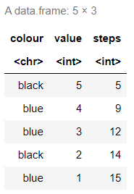
Mutating Data – Try it Out
What happens if you run this R code?

Slide 36

Mutating Data – Try it Out
What happens if you run this R code?

Slide 37
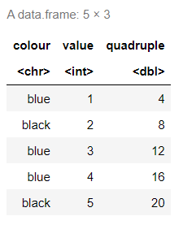
Mutating Data – Try it Out
What happens if you run this R code?

Slide 38
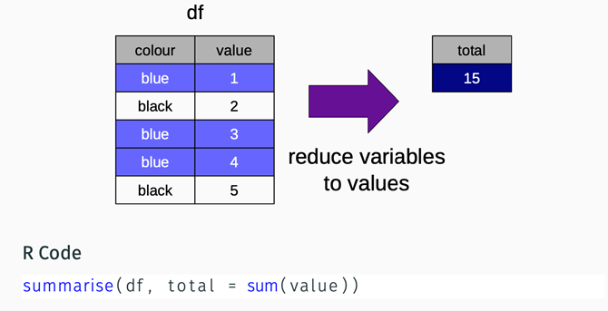
Summarising Data - Concept
Recall the summary statistics we introduced last week, we may wish to apply these to columns of values
The result in this case is a new data frame

Slide 39
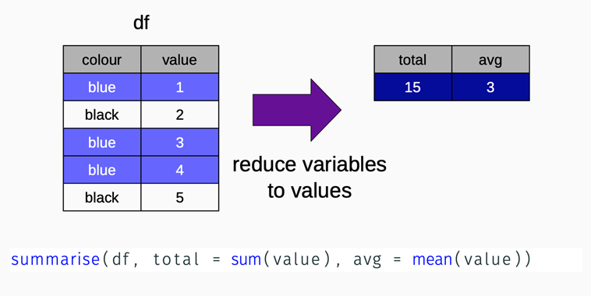
Summarising Data - Concept
More than one summary statistic may be calculated at a time

Slide 40
Task 6 - Summarising Data
Add a new column to babyNames that converts prop to a percentage. How do you do that?
Create a summary that displays the min and max prop for your name
Answer in the next slide...

Slide 41
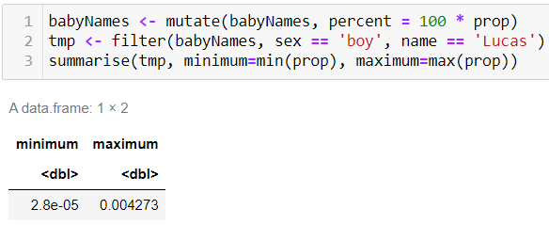
Task 6 - Answer

Slide 42
Joining Datasets with dplyr
Why might prop be a bad way to compare names across different years?
The number of babies born each year is different
We can create a births dataset:
The number of boys and girls born each year between 1880 – 2008
260 records (2 x 130)
Three variables year, sex, birth

Slide 43
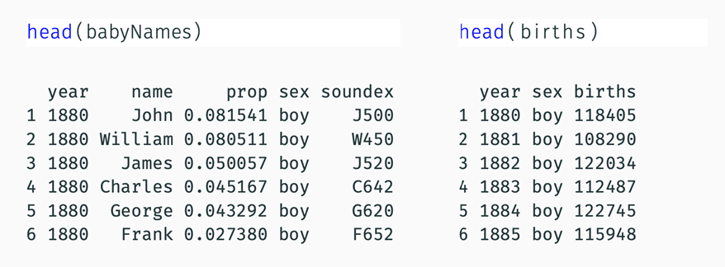
Joining Datasets with dplyr
How would you join these datasets? Describe a strategy (pseudo-code)

Slide 44
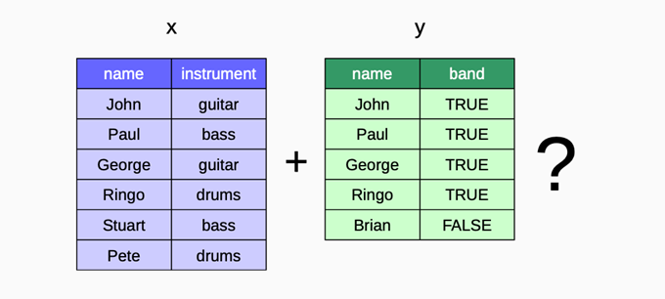
Toy Example
We will use this example dataset to explore the different ways to join dataframes

Slide 45
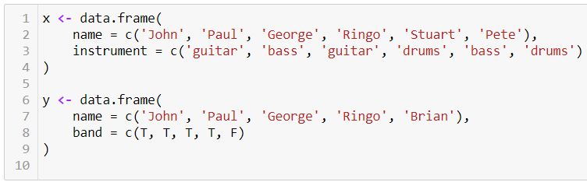
Toy Example
The code below will create these dataframes

Slide 46
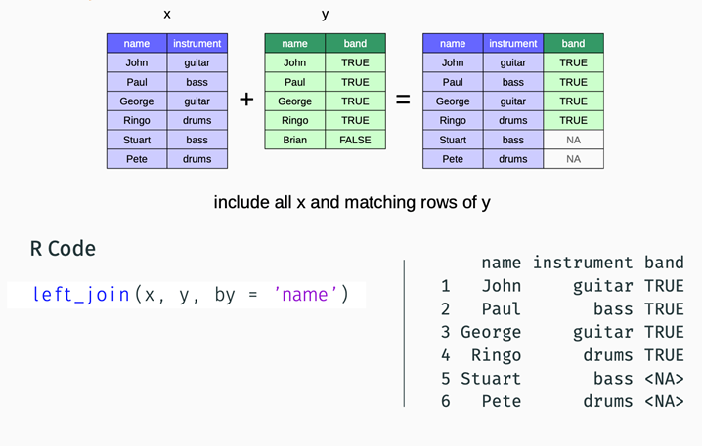
Left Join

Slide 47
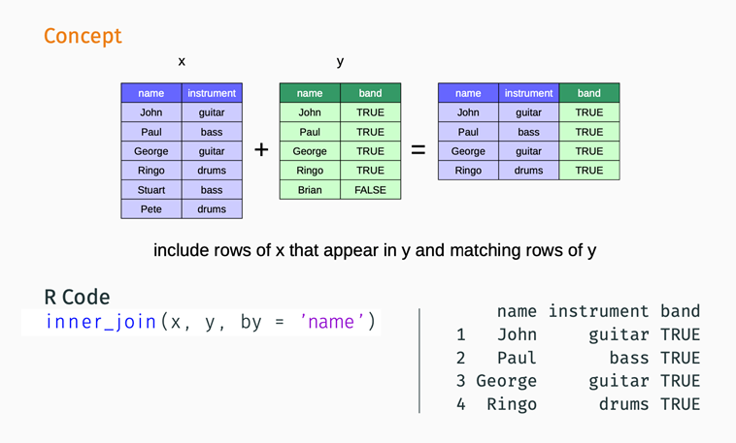
Inner Join

Slide 48
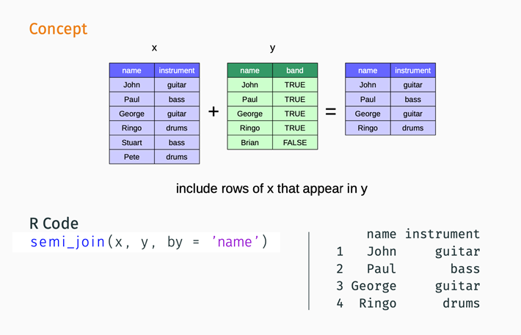
Semi-Join

Slide 49
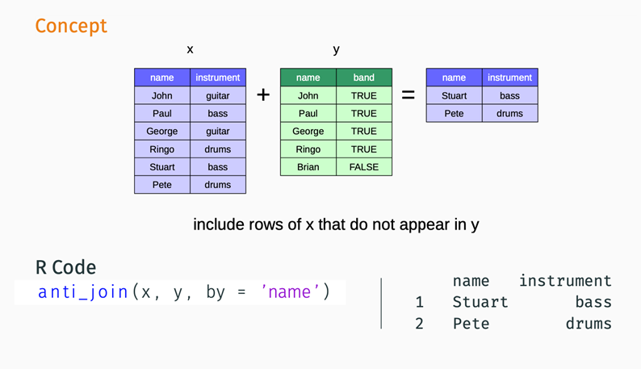
Anti-Join

Slide 50
Task 7 – Joining babyNames
Combine babyNames with births. So far, we've looked at joining on one column, only, but it's possible to join on 2.
Create a new column that shows the total number of babies born each year for each name.
Tips in the next slide...

Slide 51
Task 7 - Hints
Think about how to convert the proportion of babies born with a given name (and the total number of babies born) to find the actual number of babies born with a given name
Does it make sense to have 1.5 babies born with a particular name?
Answers in the next slide...

Slide 52
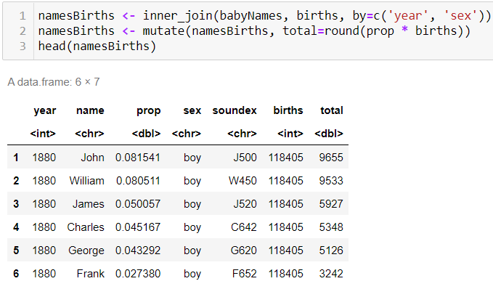
Task 7 - Answer

Slide 53
Task 8 – Grouping by Hand (in theory!)
Calculate the total number of babies born (across all years) for a single name e.g. your name
Devise a strategy for calculating the total for every name (pseudo-code, though bonus points if you implement it!)
Tips in the next slide...

Slide 54
Task 8 - Tips
To calculate totals for a single name you'll need to filter your dataset first
Can you generalise your method in part 1 to work for each name in the dataset?
You don't need to implement part 2, just have an idea of how you would do it
Answer in the next slide...

Slide 55
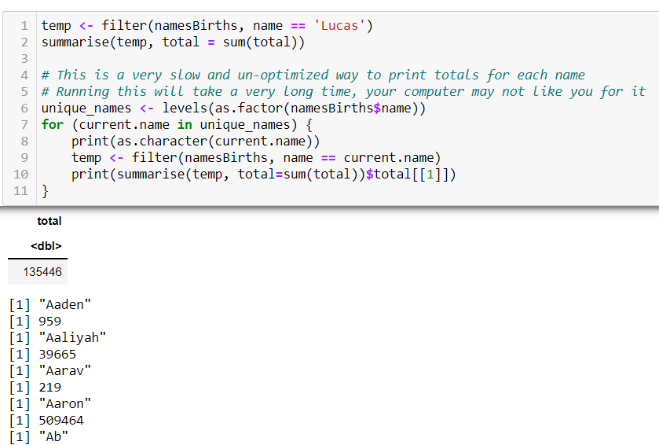
Task 8 - Answer

Slide 56
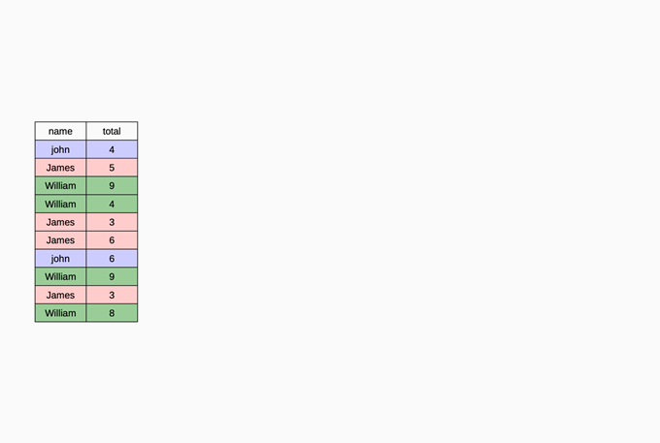
Strategy

Slide 57
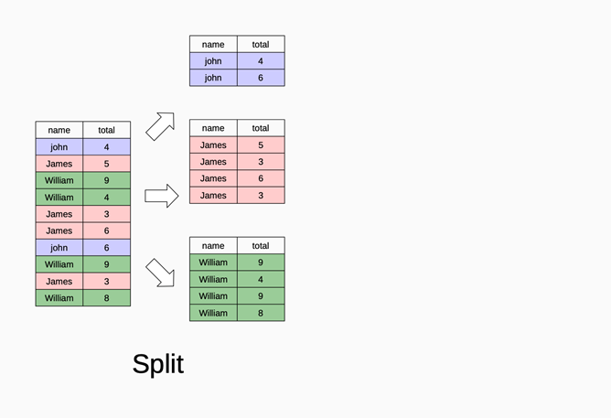
Split

Slide 58
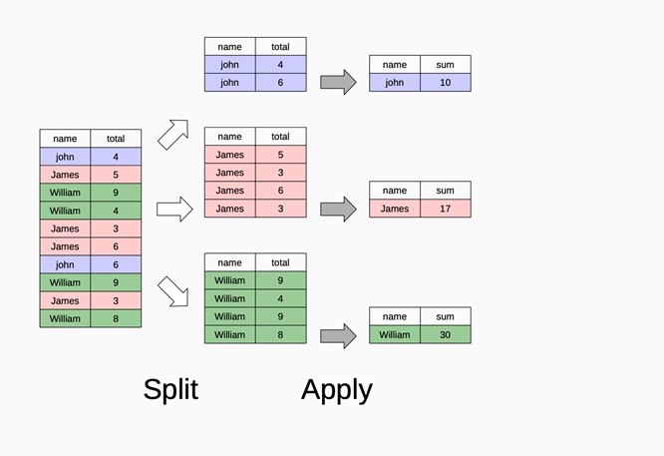
Apply

Slide 59
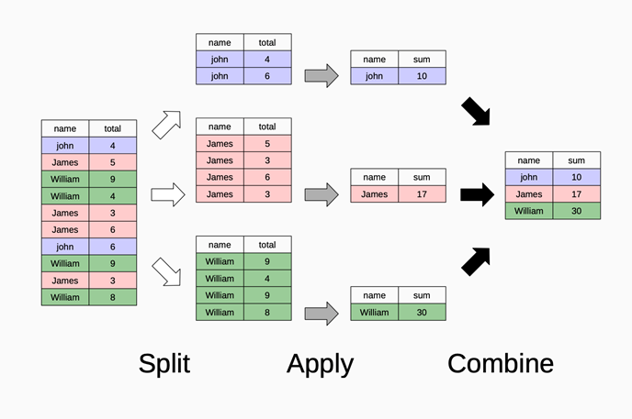
Combine

Slide 60
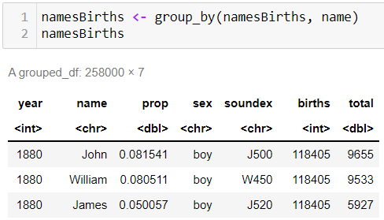
Splitting
The first step is to group the rows of the data frame by name
The result of this operation is simply the addition of groups to the metadata of the dataframe
Grouping doesn't change how the data looks (apart from listing
how it's grouped) and how it acts with the other dplyr verbs

Slide 61
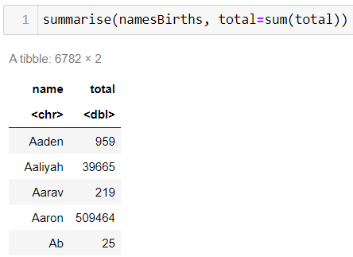
Apply and Combine
The second step applies a function to each group individually

Slide 62
Apply and Combine
Other candidate summary functions include
min, median, max, quantile
sd, var, iqr, mad
nth (Extract the first, last or nth value from a vector)
n (gives the current group size, i.e. summarise(namesBirths, n())
n_distinct (count the number of unique values in a set of vectors)

Slide 63
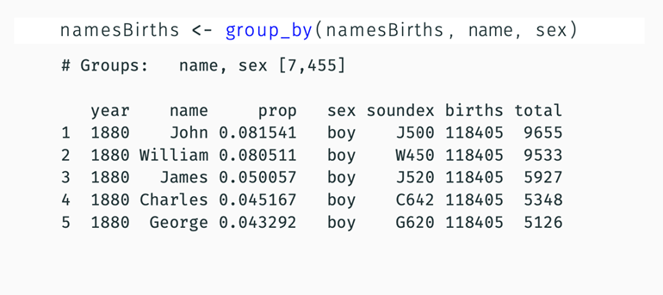
Extra Grouping Criteria
Groups may also be formed using more than one variable

Slide 64
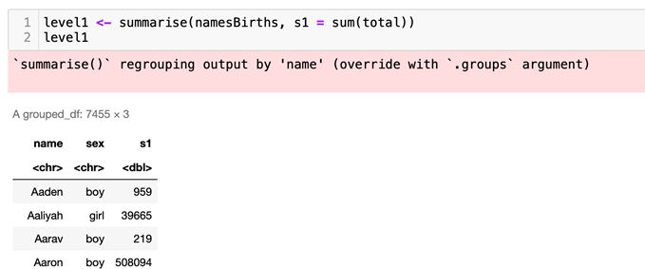
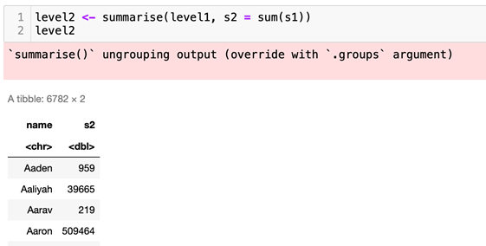
Extra Grouping Criteria
Summarising removes one level of grouping

Slide 65
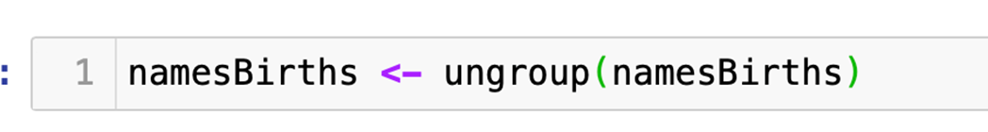
Ungrouping Data
When they are no longer required, it is best practice to remove grouping metadata with the ungroup function

Slide 66
Summary
Filter Data
Arrange Data
Mutate Data
Summarise Data
Join Data
Group Data

Slide 67
Questions?

